Slide 1
Databases for the Aspiring App Dev
Notes:
Thank you Bonnie, it’s a pleasure to speak to you all again. I’ve spoken to audiences of Southeastern students for a few years and in a variety of capacities.
At the end I’ll explain why I do all this but for now, know that I’m honored to be asked to speak here and I’m enthusiastic about what I do.
So first, let me get started with a fun little story.

Slide 2
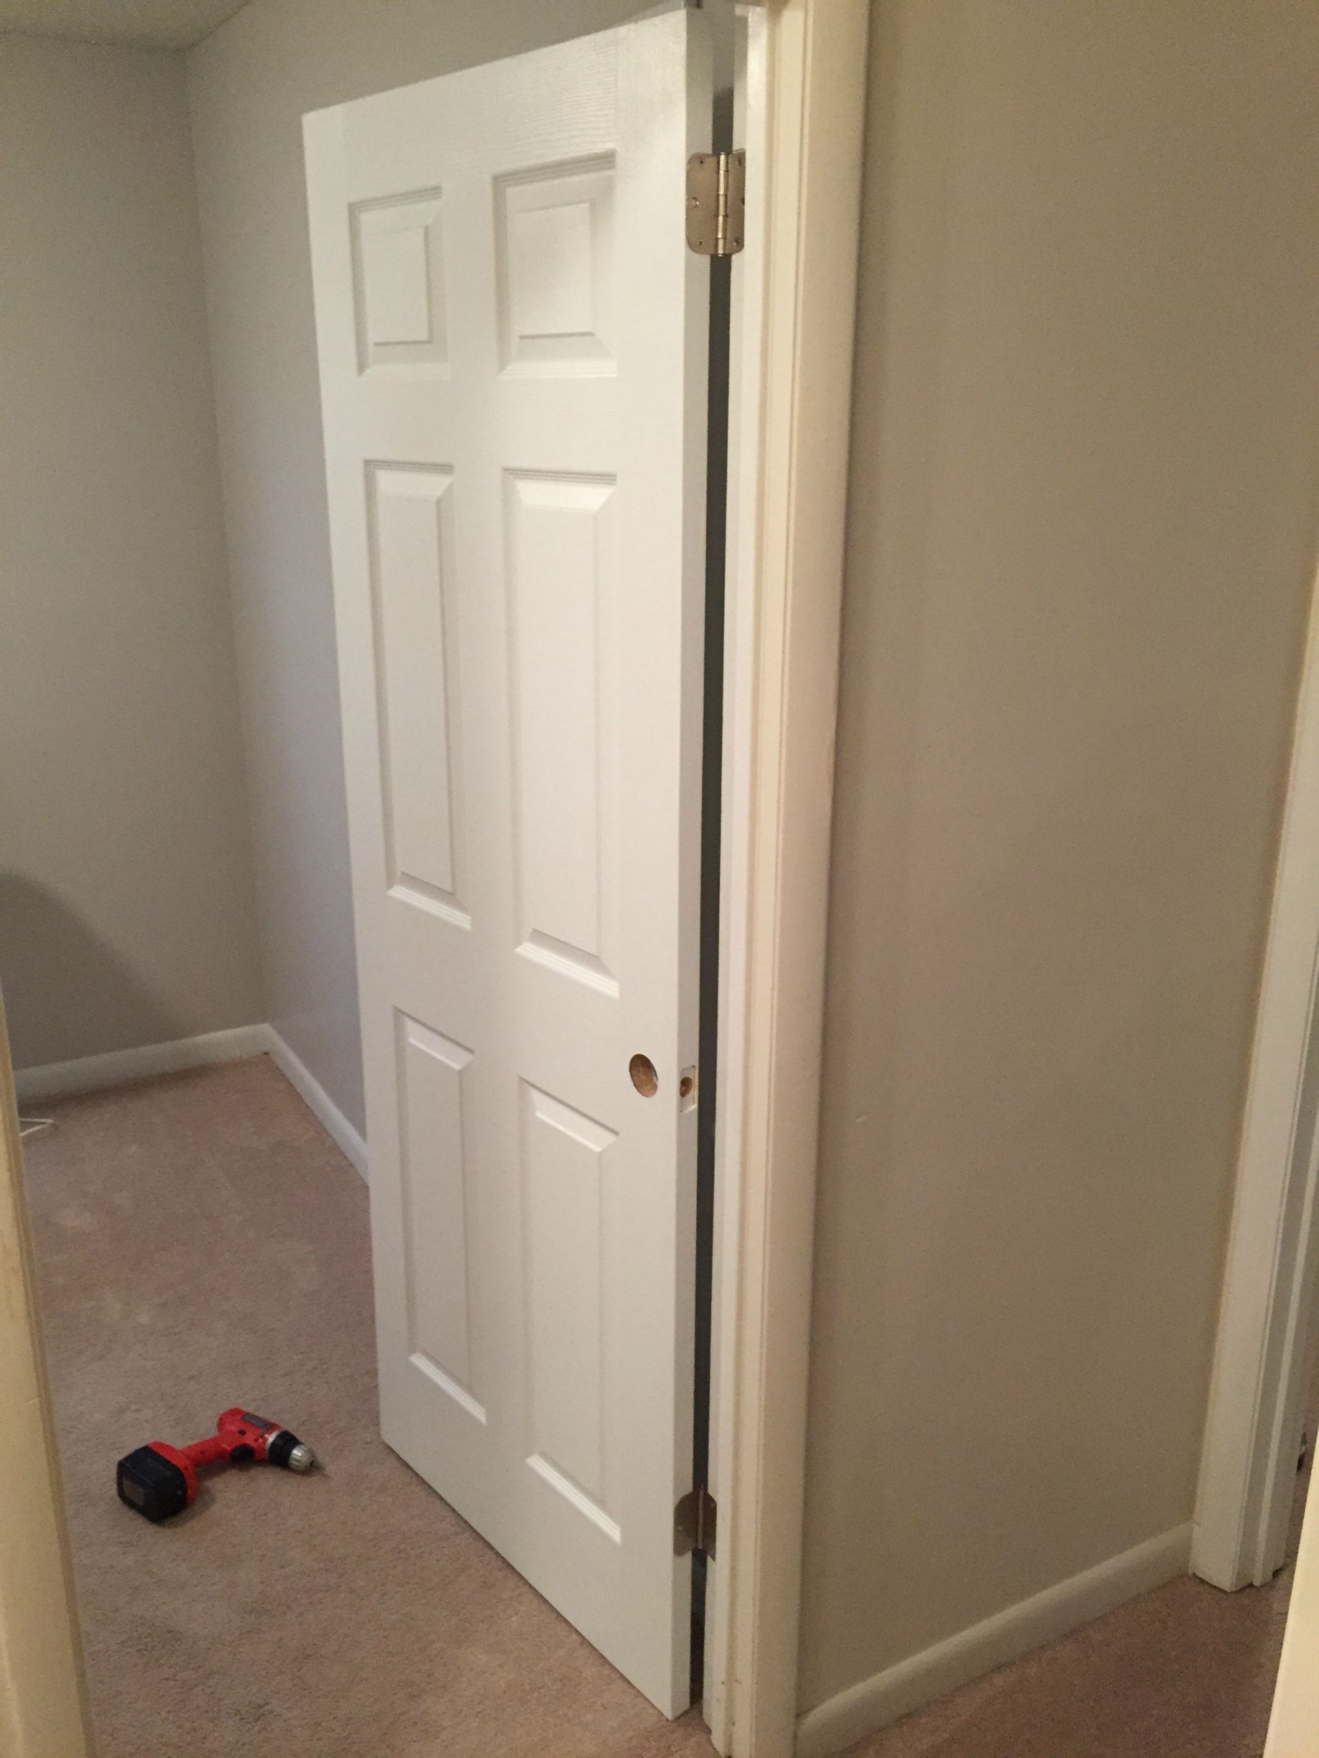

I Was Once
A Very
Lousy
Carpenter
Notes:
A little story I like to call,

Slide 3

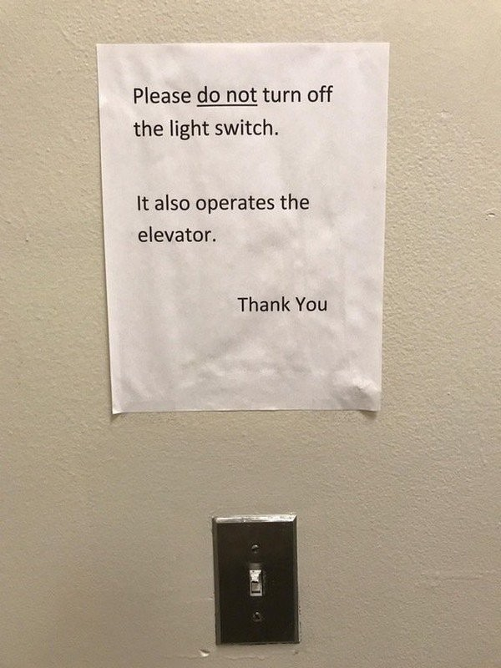
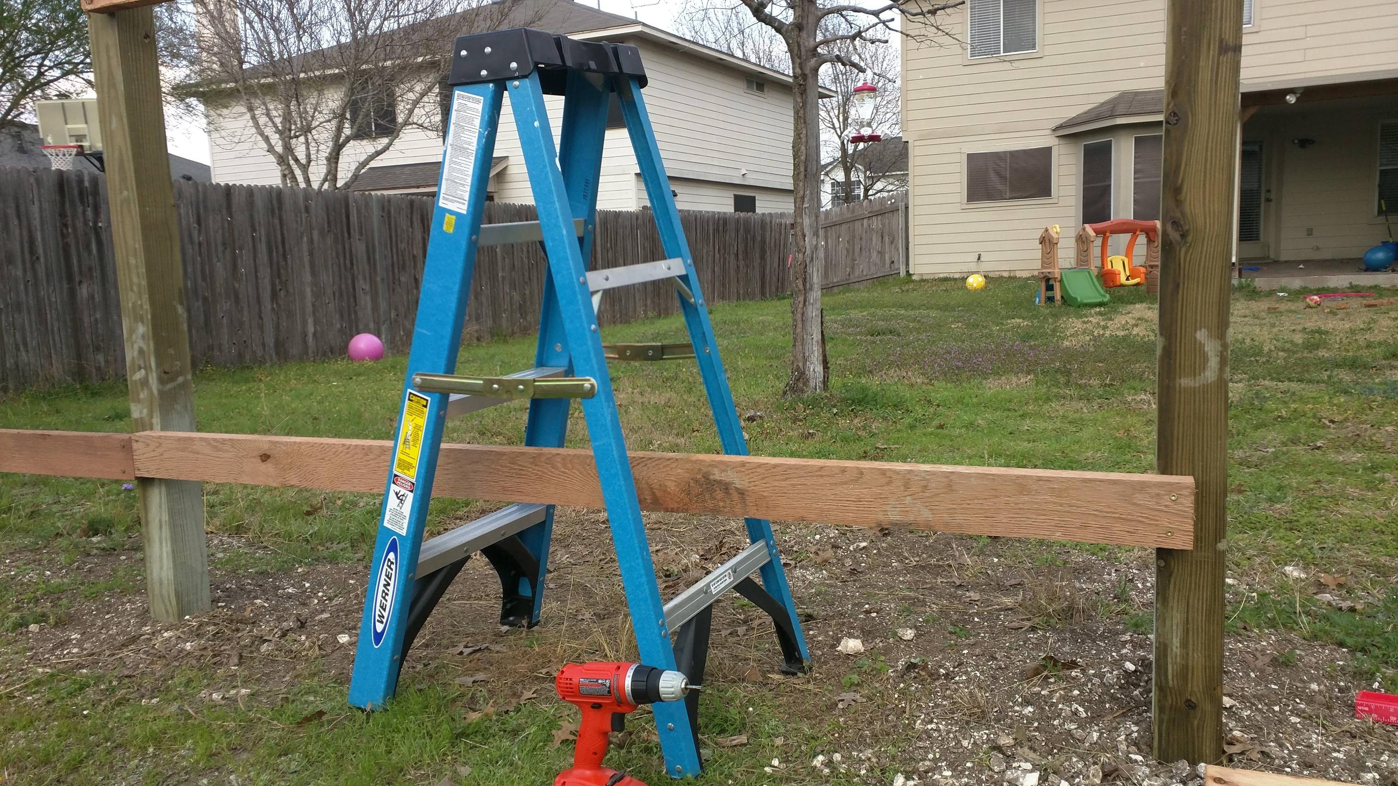
Side projects?
Interest in my work outside?
Certification exams?
User Groups and Tech Community?
Nope.
Minimum effort? Yep.

Slide 4



I did what I was told. I didn’t try to expand my skillset.
Video games weren’t going to play themselves, amiright?
I was just doing the job.
And I made goofs all the time
because it was just a job.

Slide 5


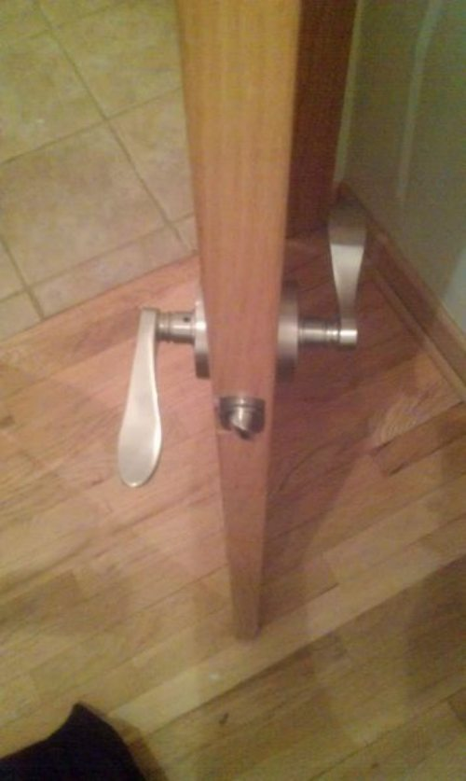
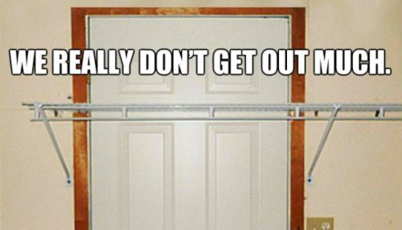
I just wasn’t very good.
I wanted be a better carpenter, I really did…
but couldn’t find time to make myself into one.
That was my employer’s responsibility...
…right?

Slide 6




Sometimes what we want to be
and what we do every day
aren’t the same thing.
Whose problem is that?

Slide 7
I started intentionally
learning again.
Did I make mistakes?
Sure. But,
I was on the path.
Notes:
<read notes first>
So I started studying on my own time.
I showed interest, paid more attention.
I stopped pointing out roadblocks, and started developing solutions.
I started attending local User Group events.
I created my own related side projects, even if no one ever knew about them.
And THEN my work started improving.
Turns out, what I was developing, were better habits around improving.

Slide 8
You are not [going to be] a very good “carpenter”
if your own house isn’t full of your own projects.
The only way to learn is to do.
Don’t expect to learn everything from your school or employer.
Notes:
<read slide first>
By all means, get the degree, and make a note of every project you complete for Alkadi because every project belongs on your resume.

Slide 9
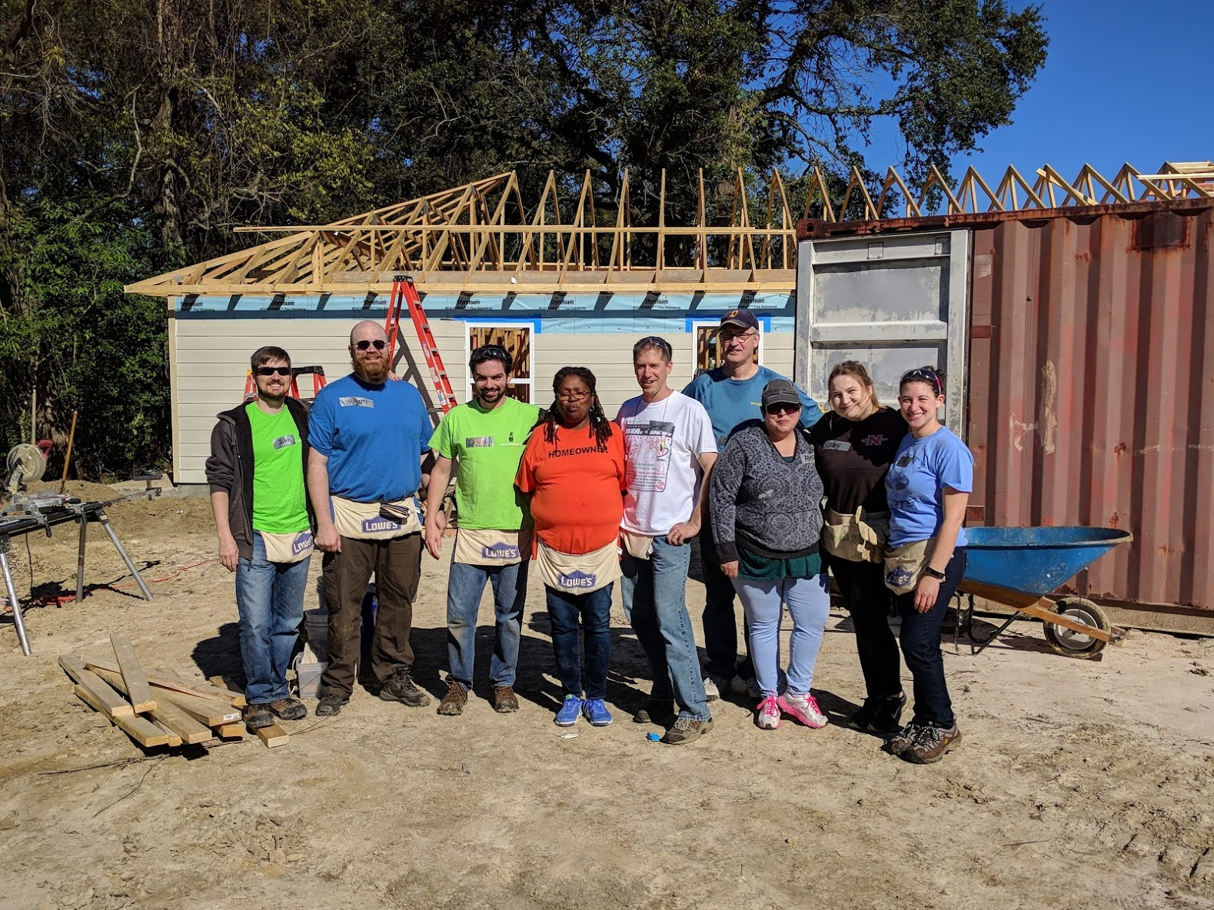

Confession Time
I’ve never actually been a carpenter.
Notes:
<read slide first>
But I have done a Habitat For Humanity build, that was pretty fun, but carpentry is a nobler profession than the havoc I see wreaked on my databases by developers.
But better habits, including my priorities in my personal time, make us better.

Slide 10
Better
New habits are like going bald.
Knew I needed to
Finally decided to shave it
Was a shock initially, not just to me but everyone
Not everyone liked it, but they got over it
Soon, I couldn’t imagine ever liking having hair
I encourage you to follow up on your desired habits.
“Those who do the things, do the things.” –my wife
Notes:
So, in summary,
<read slide>

Slide 11
Notes:
Now, let’s get started with today’s talk. I was asked to talk about what I do, which is to develop solutions in the Microsoft data platform specifically, and in databases and data structures generally. I’ll save time for questions at the end.

Slide 12

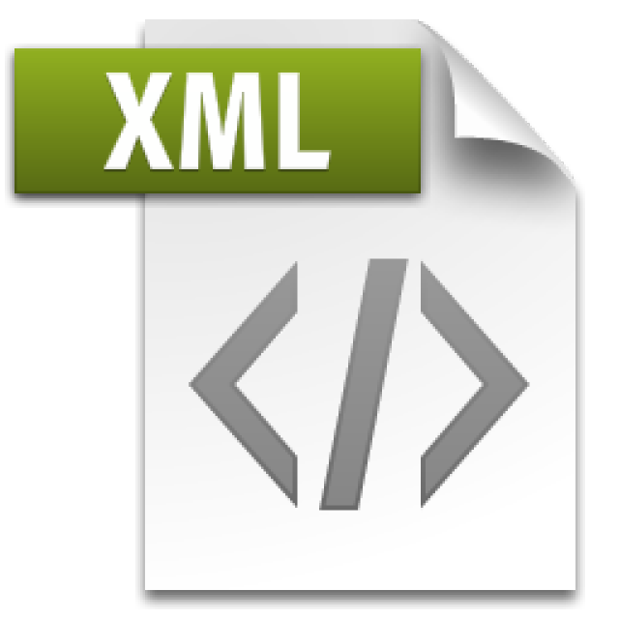
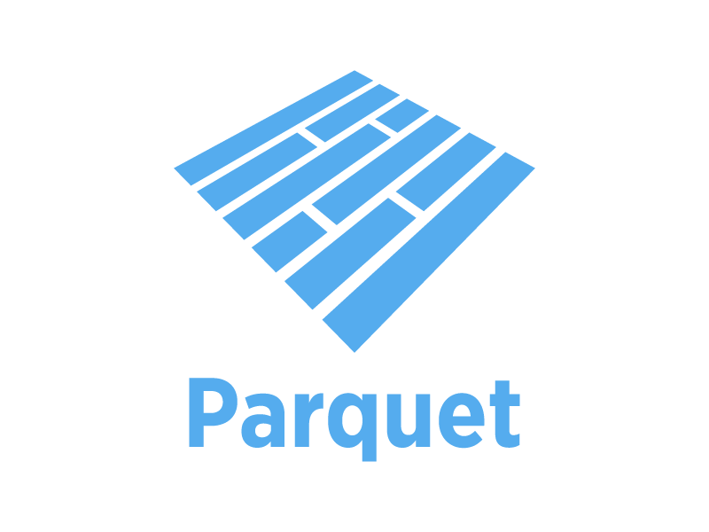
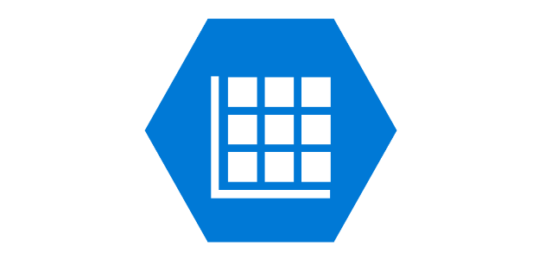
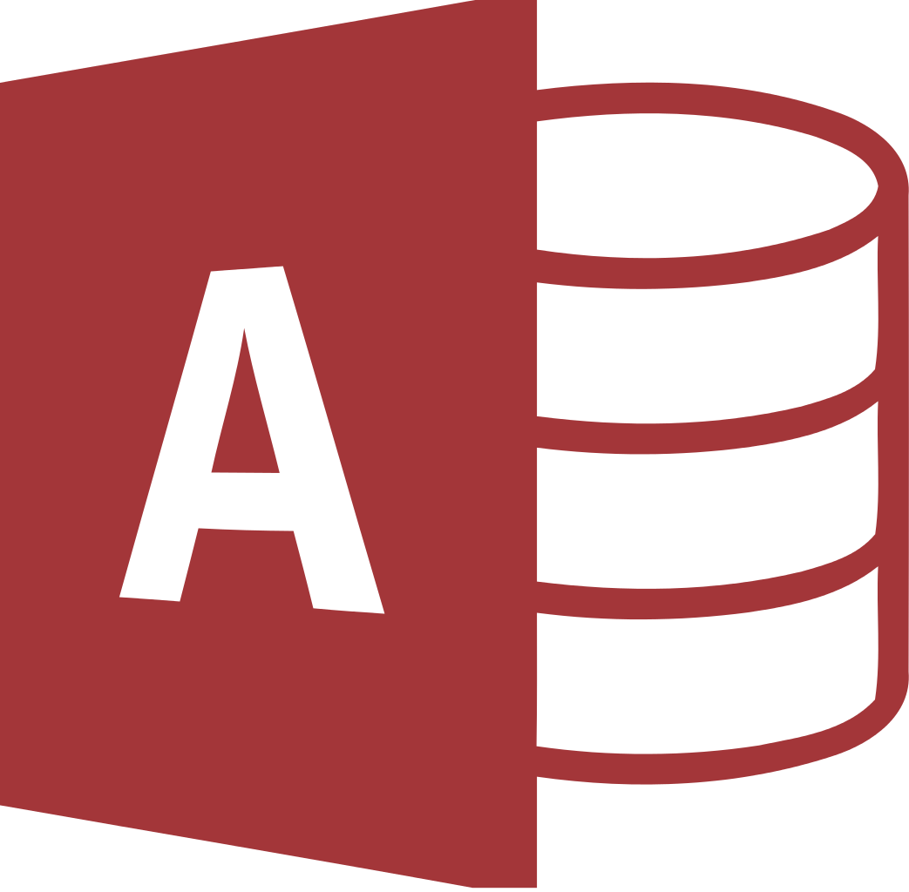
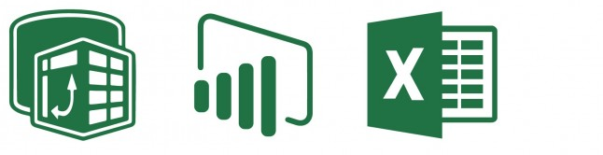
What Is Not A Database
Flat files
Comma-separated values (.csv), JSON, and XML
Columnar data files like Hadoop Parquet
Azure Table storage or similar
Microsoft Access databases
Excel - most popular BI tool in the world
Notes:
<slide first, all animations>
There are dangers of "silo'ing" data in the Access, in Excel and spreadsheets in general, PowerBI, Tableau, or any data visualization tool.
Though, valuable tools for self-service business intelligence, those Microsoft Office tools are not a database! That’s not where the data should live, but they’re fine for data analysis.
In fact, none of these options should be the primary data store of data, because none of these technologies have been designed with some key database features in mind.
Let’s talk about those features.

Slide 13
Key Features You Take for Granted
Disaster Recovery
Ex: Ability to take and restore point in time backups
High Availability
Ex: Synchronous copies, failover source to source
Transaction support
Ex: All-or-nothing writes that obey rollback/commit
Concurrency
Ex: More than 1 person working in the file at a time
Notes:
Disaster recovery
You take for granted the ability to backup and restore files, but to accomplish this you often need to involve other tools or platforms.
Given adequate levels of activity, we’ll need to be able to do backups and restores incrementally, to achieve point in time restores leveraging a chain of transactions, as opposed to haphazardly-taken copies of the whole file. A mature database platform does this, out of the box.
<click>
High Availability
We’re talking about the ability for the source to be resilient to server or site failure, to actively replicate from one site to another, and potentially, to leverage that secondary replica for read-only queries for analytics and reporting. A mature database platform does this, out of the box.
<click>
Transaction Support
Imagine you want to insert 3 rows. But something goes wrong midway through. As a developer, what scenario would you rather have, one and a half records inserted in an incomplete state, or none of them? Now, imagine it’s not 3 rows, but 3 thousand. Any mature database platform has transaction support, and even lots of new nonrelational database platforms aggressively market themselves as having “full application support”, because developers know, this is important! Nobody wants a database state to be left in an incomplete state that can’t be fully committed or rolled back. Proper transactions allow you to do all or nothing writes that commit fully or rollback fully.
<click>
Concurrency
And as important as those three things sound, this is the most important one that developers take for granted. Just like a lot of student projects fall apart as soon as Alkadi looks at them, a lot of oversimple, immature data storage layers fall apart when two users try to, say, insert data at the same time. I promise you, this isn’t a small thing to handle on your own. Don’t recreate this wheel. Databases have sophisticated internal consistency and isolation layers, that we’ll talk about, that are scalable for - up - to – millions of concurrent users. This is the only way you’d be able to handle a website that, say, handles betting during the UEFA World Cup, or trading in a stock market.

Slide 14
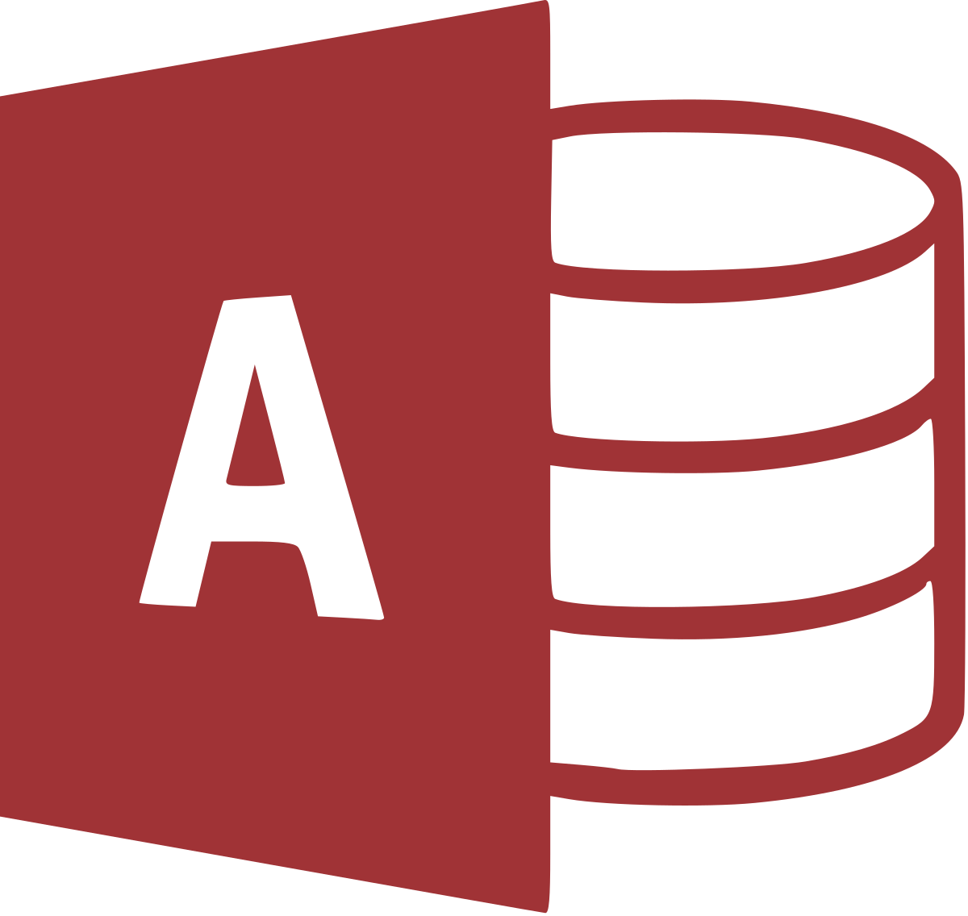
MS Access is a “Database Simulator”
Microsoft Access documentation is full of caveats about the lack of concurrency and scalability for Access.
The 32-bit "Microsoft Jet [the database engine inside Access] can only handle a limited number of sessions."
"...when multiple concurrent users make requests of a Microsoft Access database, unpredictable results may occur."
"...it was not intended (or architected) for high-stress performance..."
Appropriate as a front end ONLY. Store data in a DB!
Notes:
I want to talk about this because it’s a popular office application, it’s great for RAD, or rapid application development. My first exposure as a student to databases was with Microsoft Office 97, and even then, my underpaid, underappreciated state university instructor assured us that Access wasn’t a real database, it was more like a database simulator.
I didn’t really understand it then, I thought, hey, I’ve got tables. I can write SELECT statements. I can set data types. This has got to be the pinnacle of database technology!
It wasn’t until I entered consulting and had exposure to nightmare IT scenarios involving Access. Problems with corrupted data. Access databases on someone’s desktop that were lost to a spilled cup of coffee. Issues with integrations with other data.
Access is great for students, but thanks to your modern underpaid, underappreciated state university faculty, I know your projects are already on modern, real, grown-up data platforms like Microsoft SQL Server or MySQL, so you’ve bypassed the phase in your career where it occurs to you, “Hey, putting my entire enterprise’s operational systems, including time entry, accounts payable and receivable, and payroll in Microsoft Access, essentially a student-level database simulator, is actually a bad idea!”
But why is it is a bad idea? You need only read Microsoft’s documentation.
<next>
The 32-bit – that’s right it’s 32 bit, not 64 bit – Jet engine can only handle a limited number of sessions. How limited?
<next>
Multiple. So, uh, two.
<next>
Not intended for high stress performance is jargon for, “will not scale.” If you’ve ever been given feedback that your code works, but won’t scale, this is the code behind Microsoft Access.
<next>
Access is great for rapid development for small or single teams, for data entry forms and integrated reports, but as soon as people’s jobs or payroll start depending on this data, it’s time to get that data into a real platform.
And by the way, all of these same arguments apply to Microsoft Excel, or Google Sheets, both of which have become high programmatic and core to many large business functions that I’ve seen. Spreadsheets are not databases. Spreadsheets are not an Enterprise data management tool! They are an analysis and presentation tool, but it’s not where the data should live.

Slide 15
What Is A Database
High concurrency, high integrity, high recoverability.
All follow some implementation of a universally accepted ANSI standard for querying language:
SQL – “Structured Query Language”
SELECT … FROM … WHERE …
Microsoft’s implementation = TSQL
Oracle’s implementation = PLSQL
IBM’s implementation = SQL
Notes:
<read notes>
What’s a database? Really, it’s the only thing you should consider using to store important data, enterprise data, even game data, market data, social data, where the integrity and consistency of data is paramount. That doesn’t mean you can’t scale up, that doesn’t mean you can’t have high performance. We’ll talk more about those arguments.
All databases follow some implementation of a universally accepted ANSI standard for querying language, where the basic fundamentals of the language are the same throughout. Learn SQL, and you’ve learned the basics of a lot of different enterprise platforms.
The basics of SQL, pronounced sequel and not “ess que ell”, are universal, but many important vendor-specific features are nonstandard, not interchangeable, require cross-training. For example, from Microsoft SQL server, to Oracle, to IBM’s DB2.
Even the creation of tables and indexes or taking backups is going to vary drastically from platform to platform, even if the underlying language remains more or less adherent to a standard.

Slide 16
ACID Compliant Databases
Atomic
A transaction is all or nothing, must commit or rollback completely.
Consistent
Transaction brings the entire database from one state to another.
Isolated
Transactions, though handled concurrently, are still processed sequentially and independently.
Incomplete transactions should not be visible to other transactions.
Durable
If the power goes off, the data is still there. It's not in volatile memory.
Notes:
<read notes first>
Ok, let’s talk more specifically, and perhaps more academically, of what actually defines a database, and the industry term, ACID-compliant database.
Why is it called ACID, not CAID, or Cadi, or Cida, or Dacy? I dunno, it’s probably because all of this database stuff was invented in the 70s.
<next>
Atomic
We talked about this earlier as something that developers take for granted. A transaction is committed or rolled back entirely. The database can’t be left in a partially committed state by any sort of failure, software or hardware.
<next>
Consistent
Transaction brings the entire database from one state to another - not just a single part of the database, not just the part of the database the user was accessing. This affects both how users interact with the same database, but also, how partitions or shards of the database behave together. While many databases have a single primary node, there are architectures that allow for multi-primary database nodes, that can accept transactions regionally, for example, and merge their changes together.
That inevitably involves something like eventual consistency. Eventually consistent databases can’t claim to be ACID compliant, but that can be useful - Cassandra, MongoDB, Redis, or the database platform that Twitter wrote for itself, Manhattan. Twitter cannot commit a transaction globally, consistently, synchronously.
Your hot taek tweet takes some time to globally propagate through the distributed system.
<next>
Isolated
Isolation and various isolation levels are crucial to understanding database access and the basics of how rows become locked, and various types of locks. It means transactions line up, and potentially block eachother, so that they can each do their thing to the database sequentially, independently. By default, most ACID compliant databases operate with a pessimistic locking strategy, assuming that we need to protect multiple requests from eachother. Reads lock writes while they’re reading, and writes lock reads while they’re writing. This is part of very basic functionality around the concept of committed data, and only wanting to read data that has been committed to the database, as opposed to data that has yet to be committed. Incomplete transactions should not be visible.
<next>
And finally, Durability, which seems pretty obvious, but this was very crucial back in the day when nonvolatile storage wasn’t cheap but volatile storage was even more expensive. This is still the case today. Even if your nonvolatile memory isn’t on spinning disks but on flash or ssd storage, the availability of volatile memory is still crucial to the performance of your database. Databases could all run much, much faster if we promised to never turn them off. But eventually, data must be hardened to nonvolatile memory, and that takes time. And that hardening to nonvolatile memory is what makes your data survivable.
All of these aspects of ACID may be violated in name of performance. Most database platforms have advanced features to allow a developer to violate them, especially consistency and durability. As long as the devs are aware of what they’re doing, it’s probably ok. But again, that JSON file you’re using for your entire data layer doesn’t promise you really any of these.

Slide 17
Pessimistic vs Optimistic Locking
Pessimistic Concurrency
I would rather you wait than fail.
Block other transactions from reading the data I’m writing, vv.
Most data integrity, consistency.
Optimistic Concurrency
I would rather you fail than wait.
High transaction failure rates demand sophisticated retry logic.
Need to automatically, quickly solve transaction conflicts.
All but required for multi-primary database clusters.
Notes:
We won’t spend a ton of time here, but key here really is about updates. Inserts and deletes and how they interact with selects are easy enough, but updates… that’s the tricky part.
Pessimistic transactions would rather your update wait for exclusive access to data than try to update data that’s already changed, or changing. If you can’t guarantee your update will be isolated, then wait. It assumes more than one cook in the kitchen, and that’s safer.
Optimistic transactions assume nobody else will be trying to change the ingredients, but if they do, somebody’s going to get burnt. And that’s ok, because they’ll just have to try again. And that’s as far as my tortured metaphor takes it, but optimistic transactions require the application, perhaps independently of the database, to quickly solve transaction conflicts, resolve merged data, pick winners, and cause losing transactions to fail. Optimistic transactions fail when you go to delete or update rows, and they’re not there any more, or you go to read or update rows, and the rows or rowcounts have changed. It can become a real tangle, and the database and application need to be more sophisticated about transaction management, tiebreaking, and retry logic.
If you’re not sure what to decide, review your system’s business requirements. A stock market where everyone must have access to the same price at the same time, and the price changes? Pessimistic concurrency is needed, or the market won’t be fair or trusted.
Creating the next global social media app? Optimistic concurrency allows for globally distributed data that inserts well and scales for reads infinitely, but boy are updates a pain, and who cares if my tweet doesn’t show up in Egypt right away.
Something in between? I’d recommend starting with safety, and violating ACID principles only on demand, but not by design.

Slide 18
Relational (RDBMS) or SQL DBs
Typically use tables, columns.
ACID compliant by default, especially strong around transactions. Good for high-integrity, highly-concurrency.
Key enforcement, between tables and uniqueness within tables, is important.
Reporting and analysis is easy.
Microsoft SQL Server, Oracle Database, MySQL, IBM DB2, SQLite, PostgreSQL, MariaDB, Teradata
Notes:
<read notes instead>
Relational databases or as you might see, RDBMS, relational database management system.
NASDAQ runs on SQL Server, a relational database engine.
The database behind bwin, the largest sports gambling site in Europe, runs on Microsoft SQL Server.
StackOverflow, the website where much of your homework comes from, Dell.com, the FOX Sports Mobile App, all run on Microsoft SQL Server.
These workloads need to process millions of transactions per second while also processing them with integrity, with reliability, and without high rates of transaction failures.
Key enforcement, between tables and uniqueness within tables, is important.
Relational database solutions were generally designed for single-server architectures, but this is not the rule. Sharded or partitioned architectures are possible, but are not as easy or simple.
Finally, relational database systems allow for analytical-style queries that joins data across many tables. This gets tricky without enforced data integrity across common keys, for example.

Slide 19
NoSQL DBs
Not a product, but a category of specialized DBs.
Non-relational. Different than table/row/column.
Often designed for sharded, partitioned architectures with multi-primary or regionally-primary DBs.
Reporting and analysis difficult, must transform.
Azure Cosmos DB, Amazon DynamoDB, Amazon Simple DB, Mongo DB, Cassandra, Redis
Notes:
<read notes instead>
NOSQL databases are a category of database platforms that are designed intentionally and specifically around a different data structure or to specifically break ACID compliant rules.
NoSQL databases are more defined by how the store data than anything. Although many early NoSQL databases were open source, that’s not a defining feature, there are many open source relational databases, like MySQL or MariaDB, and there are many proprietary NoSQL databases commercially available as well, from all the major technology vendors like Microsoft, Oracle, and AWS.
Non-relational data is less concerned about foreign key enforcement, uniqueness enforcement, or the ability to join data together, and more about the speed and scale of data retrieval and data writes. NoSQL databases may store data in documents, or in key value pairs, or in graph nodes, each specifically designed for that model of data. As a result, analytical-style queries across large swaths of joined data are difficult.
Many will argue that NoSQL isn’t a database, but just fancier doc storage with an API on top, and there’s both an oversimplification and a hint of truth in that.

Slide 20
SQL or NoSQL?
Unstructured data is a common use case for NoSQL, but you can accomplish this storage with a SQL DB.
SQL databases can store blobs, json documents, xml documents natively, in-row with other relational data.
SQL sharded architectures are possible but not easy.
NoSQL violates ACID compliance by default, especially the C for consistency. Shards are easy.
Rapid, horizontal scaling with SQL solutions can be more complex than with NoSQL solutions.
Notes:
<read slide>
<read comments>
This is a common SQL Server pattern for health care data (HL7) and credit reports, for example, which have a vast complex schema, only a small portion of possible values are ever populated in any given set for a patient or a borrower. These complex data documents often don’t make sense to break out into a normalized table design with tables and columns for each possible value.
<next, read comments>
NoSQL databases typically violate ACID compliance by default, especially the C for consistency, allowing for that eventual consistency we talked about earlier. NoSQL databases are designed for sharded data, stretched over geographies between data centers. NoSQL partitioned architectures can have multi-primary or regionally-primary databases, by design. For example, Microsoft Azure CosmosDB can create multi-primary partitions at any Azure Datacenter in the world with the click of a button in a web browser.
Rapid horizontal scaling with SQL solutions can be more complex than with NoSQL solutions.
Vertical scaling, by the way, means having a bigger, faster server with more CPU, more memory. Pretty simple.
Horizontal scaling means having more servers hosting the same data. They can be distributed across various data centers, on various continents, even. This is more complex, but lots of NoSQL database platforms are designed for this, they have transaction coordinators and bidirectional synchronization built in, making it easy for developers.

Slide 21
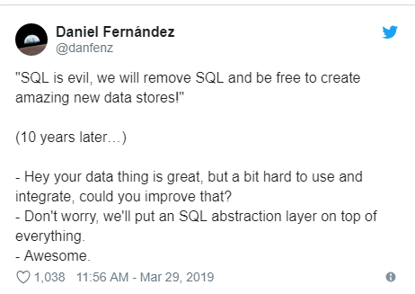
When not to use NoSQL?
Notes:
<read notes>
A quick story here about the evolution of NoSQL databases.
<read tweet>
To search, analyze, calculate, aggregate across ranges of rows in a NoSQL platform, it often must be extracted from documents and transformed (even if this is done behind the scenes).
Don’t decide to use a NoSQL platform just based on your desired write functionality. You need to consider your eventual analytical read functionality, as well as integration with other data.
NoSQL solutions often must be packaged with a separate product for analytical/aggregate reporting consumption. For example, MongoDB’s Enterprise BI connector serves up data for business intelligence… via a MySQL database… they had to build a SQL solution into their NoSQL platform just to provide reports!

Slide 22
When not to use NoSQL?
Don’t use NoSQL as your primary data platform just to avoid things like data types, foreign keys, constraints, etc. That stuff isn’t so bad.
Don’t use NoSQL just because you’re “open source”.
Don’t use NoSQL just to be “agile”.
Don’t use NoSQL just because you don’t know what your data looks like yet.
Notes:
<read slide>
<next>
Don’t ever do something just because it sounds more “open source” or “agile”. That’s more of an ideology than a technology decision.
<next>
That last one is key. NoSQL doesn’t necessarily make feature growth or data expansion easier. That’s already difficult enough to manage.

Slide 23
Like Peanut Butter and Jelly
In reality, in your application environment, there could be good use cases for both SQL and NoSQL platforms that properly use the strengths of each.
SQL database
OnLine Transactional processing (OLTP) of data, complex transactions
Master data management, reference for external integration API’s
Reporting, foundation for other analytical systems (OLAP)
NoSQL platform
Imports from rapidly-changing or complex external data
IoT or streamed data massive-scale writes (aka a Data Lake)
Continuously, procedurally-modified schemas
Notes:
<read notes>
In reality, in your future business environment, there could be good use cases for both SQL and NoSQL platforms that properly use the strengths of each.
Many large platforms will feature both a relational database for transactional data and a NoSQL database, especially an in-memory or cached database, for responding to search requests.
I worked with a large southern bank with SQL Server its backend core processing, but a vendor-supplied Mongo DB for its website usage analytics.
The website Reddit.com, uses both PostGres, a relational database platform, and Cassandra, a NoSQL database platform, for different features.
Facebook was initially designed with both a MySQL relational database backend, as well as a Memcached front end to serve up quick web results.

Slide 24
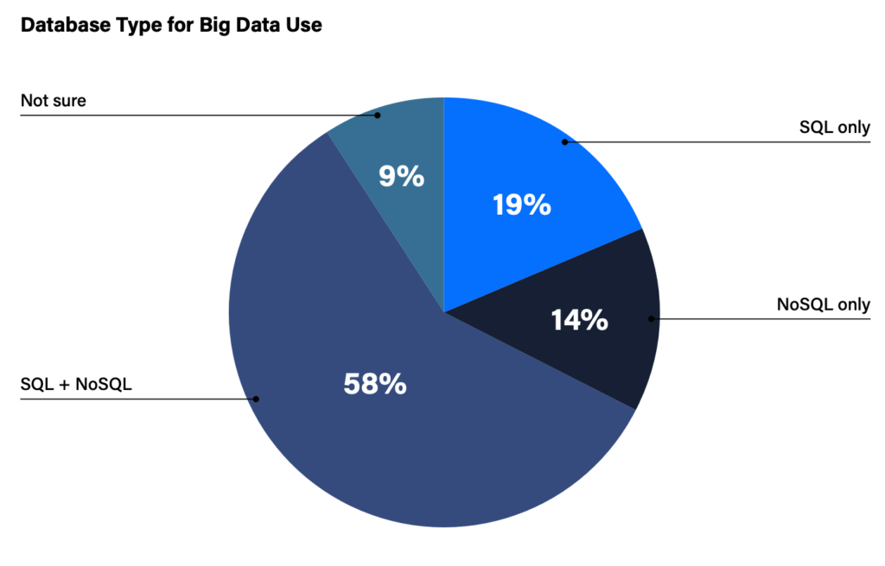
NoSQL + SQL
Image: https://dzone.com/articles/nosql-vs-newsql-vs-distributed-sql-dzones-2020-tre
Notes:
In a recent survey, 58% of companies already use both SQL and NoSQL in their enterprise for use with Big Data, side by side.
As platforms vie to take serve modern demands for the strengths of both SQL and NoSQL, understand that this decision really comes down to understanding your database’s workload and your business’ requirements. NoSQL will never kill SQL, and vice versa.

Slide 25
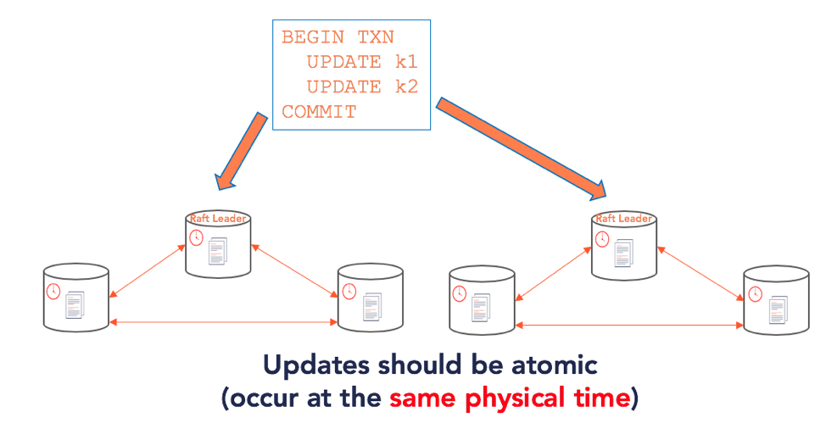
Emerging
Unified database platform with API-driven versatility
Azure Cosmos DB – unify NoSQL specializations
SQL+NoSQL via “distributed SQL” or NewSQL
The magic is in sophisticated distributed transaction managers
TAO, Spanner, YugabyteDB, CockroachDB
https://blog.yugabyte.com/distributed-postgresql-on-a-google-spanner-architecture-storage-layer/
Notes:
<read notes instead>
The big relational database platforms really can provide capability to serve existing workloads in a variety of ways. But new database platforms are emerging to meet modern, planet-scale workload demands. New, specialized database design patterns emerge because there is demand for them.
<next>
For example, Azure Cosmos DB is a recent major commercial product to take this approach, a new platform providing API’s that make Cosmos DB walk and talk like leading NoSQL, key-value, document, and graph database platforms, making an effort to unify various narrowly specialized NoSQL databases into a single, global-scale platform backed by Microsoft’s global array of Azure datacenters. If you were to write the next Twitter in Microsoft tech, you’d base it on Azure Cosmos DB.
<next>
The newest emerging database platforms are seeking to merge the flexibility and integrity of SQL database with the scalability of NoSQL databases, and a new phrase: NewSQL.
So-called NewSQL platforms are emerging trying to provide globally-consistent databases. Both Facebook and Google now operate on their own home-grown platforms, TAO and Spanner, that try to provide database consistency, safe transactional processing and limitless horizontal scale. These new database platforms are built specifically for massive cloud clusters, and require the development of sophisticated distributed transaction managers. Google’s Spanner has been made open source, and is the foundation of YugaByteDB, an emerging NewSQL data platform that uses Spanner on top of PostGres.

Slide 26
Summary
Databases good.
Hug a database today. Hug a DBA only with permission.
A flat file by any other name is still a flat file.
When it doubt, choose SQL, scale up.
Most features, versatility, integrity.
Monolith shmonolith.
Scale out if geographically necessary with NoSQL.
Look for specific advantages, not buzzwords. Test it out.
Keep in mind, you’re probably not special.
The future is exciting!
A republic, if you can keep it.
Notes:
Databases good. Don’t be scared of them. Don’t scoff at that layer of work. It was being assigned the database layer in my senior software project that really helped me start understanding and appreciating the data layer. Don’t shy away from that work in future team projects.
Hug a database today. Hug a DBA only with permission.
And remember, a flat file by any other name is still a flat file, I’m looking at you, JSON.
<next>
When it doubt, choose SQL, scale up. Relational platforms Microsoft SQL Server provide the most features, versatility, integrity, and integration out of the both. You can do many NoSQL patterns from within a SQL Server. Monolith shmonolith, relational systems are actually the most versatile.
<next>
Scale out if geographically necessary with NoSQL.
Look for specific advantages, not buzzwords. Test it out. Man there are a lot of databases out there, just waiting to be the boat anchors of future startups. Consider platform capability wisely.
Keep in mind, you’re probably not special. Your data can probably be adapted to a platform that doesn’t force you to recreate the wheel and engineer your way out of an overspecialized, too narrow database platform.
The future is exciting.
Please, you are the youth. If you’re not optimistic about the future of databases and everything else right now, who will be? Please use your energy and enthusiasm to better the world for everybody, please use your powers of programming for good and your data ethically, and please give back to the generation that follows you, even if you don’t understand their music, even if it isn’t your alma mater.

Slide 27
Questions?
Notes:
Thank you

